Slide 1
Electrical System
Team 2655
2016 FIRST Stronghold

Slide 2
Battery

Slide 3
Power Distribution Panel (PDP)

Slide 4
RoboRIO

Slide 5
Pneumatic Control Module (PCM)

Slide 6
Voltage Regulator Module (VRM)

Slide 7
CAN Talon SRX Motor Controller (SRX)

Slide 8
Victor SP Motor Controller (SP)

Slide 9
Wi-Fi Radio

Slide 10
CIM

Slide 11
Compressor

Slide 12
Solenoid

Slide 13
Drive System
The drive system consists of four CIM motors that are each powered by CAN Talon SRX Motor controllers.
There are two motors on each gear box.
One gear box drives each side of the robot.

Slide 14
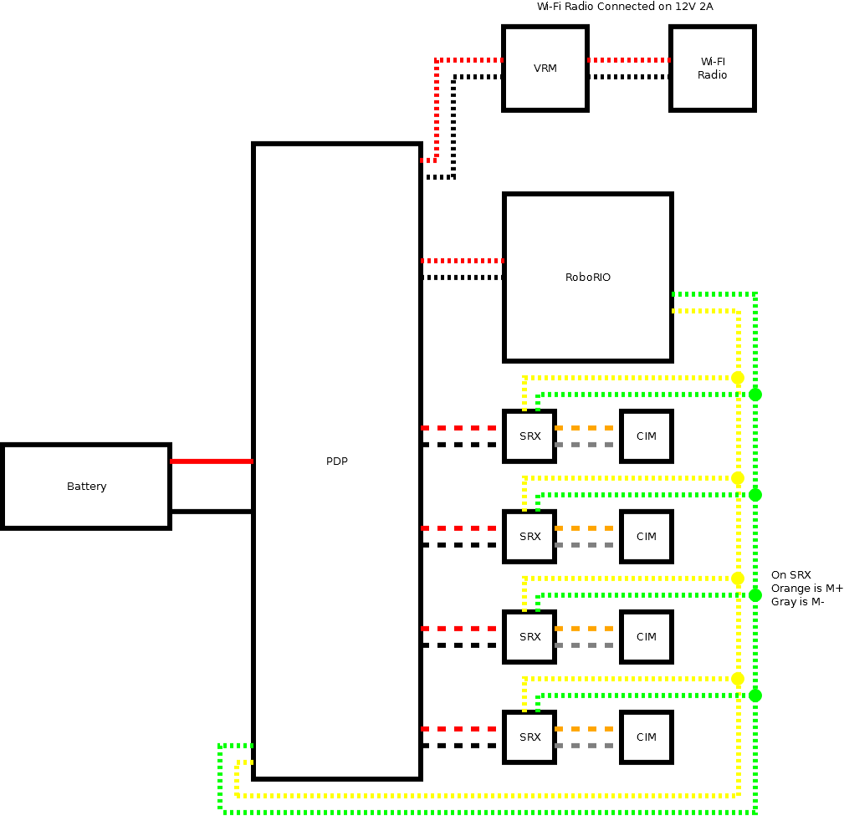
Drive System

Slide 15
Ball Intake
The ball intake consists of a four-bar linkage powered by two pneumatic cylinders.
Both cylinders are controlled by a single bi-directional solenoid.
There is one Mini-CIM motor with a 3:1 planetary gearbox on the front of the ball intake to hold on to the ball.
The CIM is controlled by a Victor SP.

Slide 16
Defense Destroyer
The defense destroyer is a two-bar linkage powered by two pneumatic cylinders, one on each side.
Both cylinders are controlled by one bi-directional solenoid.

Slide 17
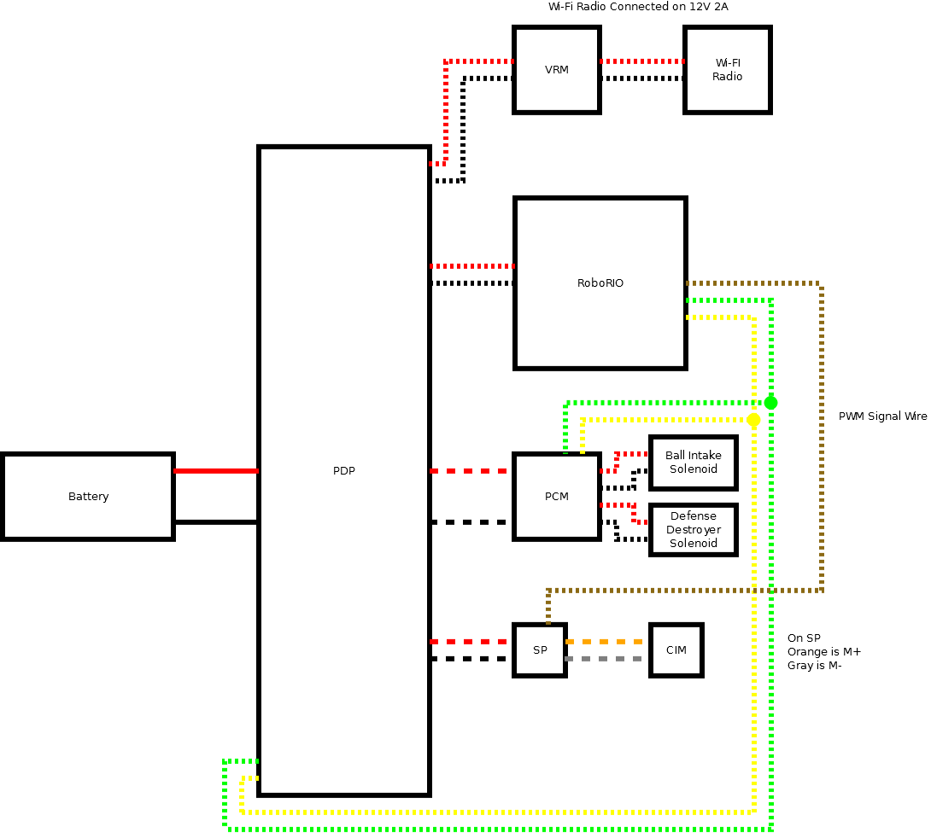
Ball Intake and Defense Destroyer

Slide 18
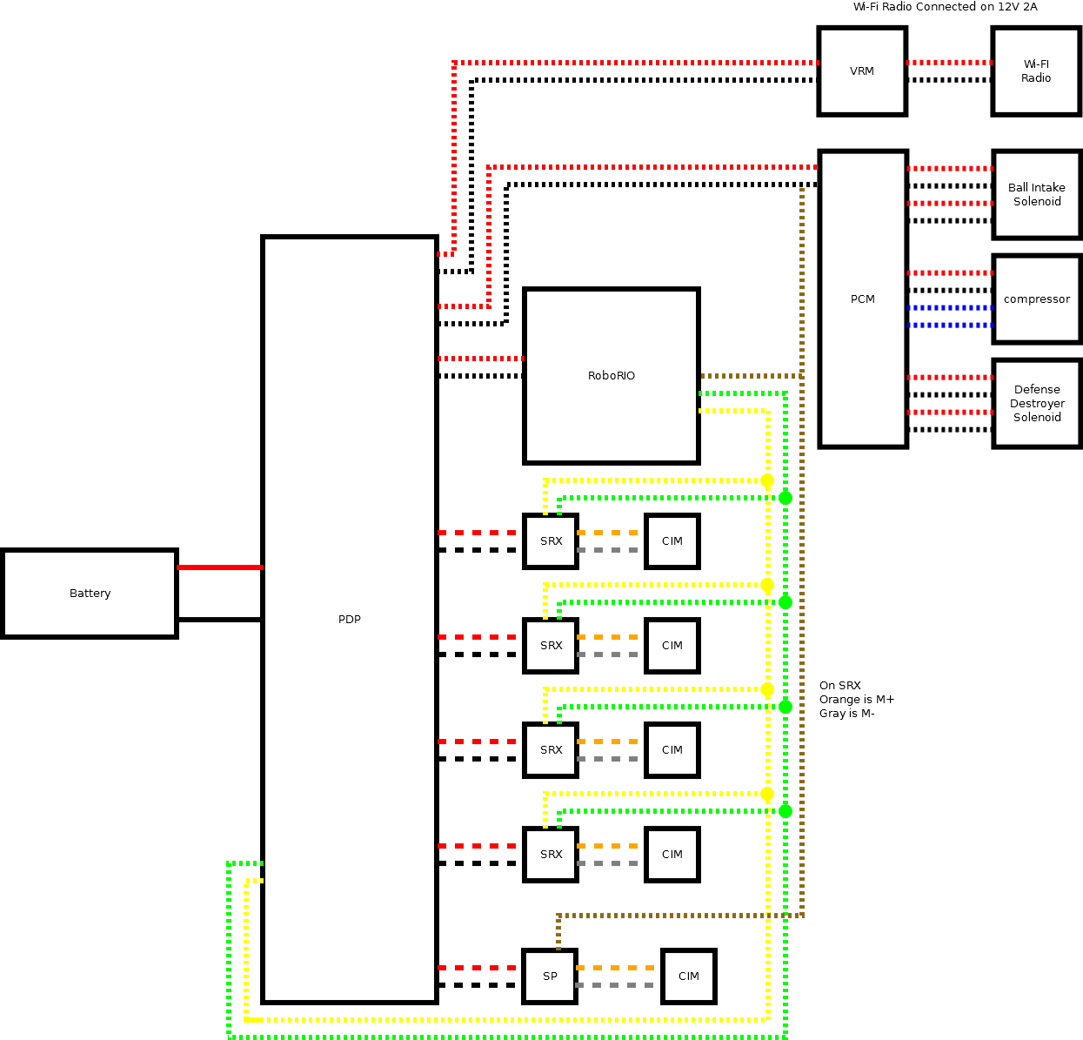
Full Electrical System

Slide 19
Pneumatic System
The PCM is connected to the RoboRIO via the CAN bus.
The compressor and limit switch connected to the PCM, as per the rules.
There are two solenoids on the robot; one for the ball intake, one for the defense destroyer.
The compressor stores air in two tanks at 120 PSI.
The solenoids are fed regulated 60 PSI air.
Each solenoid actuates either pair of cylinders in one direction or the other.

Slide 20
Pneumatic System

